Slide 1
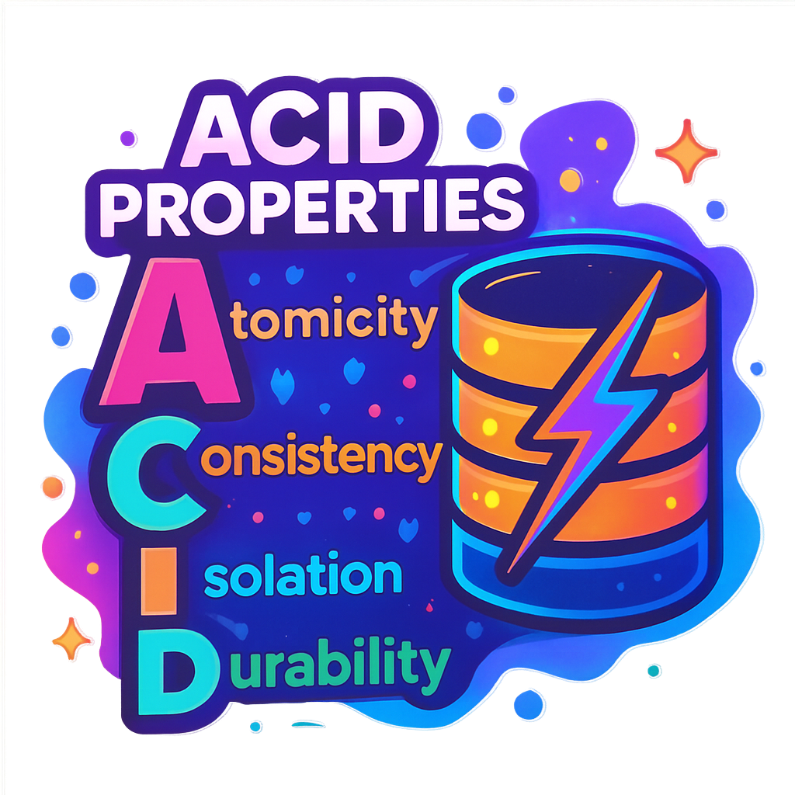
What are ACID Transactions in Databases?
A transaction in the context of databases is a sequence of one or more operations (such as inserting, updating, or deleting records) that the database treats as one single action. It either fully succeeds or fully fails, with no in-between states.
Example: Bank Transfer
When you send money to a friend, two things happen:
Money is deducted from your account.
Money is added to their account.
These two steps form one transaction. If either step fails, both are canceled.
Without transactions, databases could end up in inconsistent states.
For example:
Partial updates: Your money is deducted, but your friend never receives it.
Conflicts: Two people booking the last movie ticket at the same time.
Transactions solve these problems by enforcing rules like ACID properties (Atomicity, Consistency, Isolation, Durability).

Slide 2
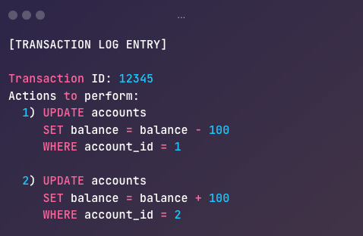
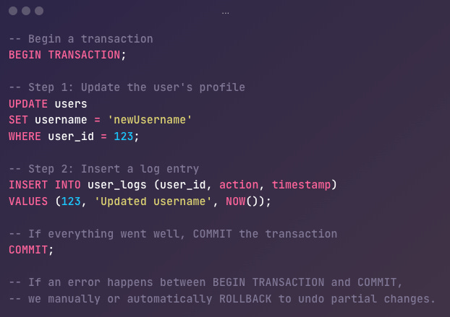
Atomicity
Atomicity ensures that a transaction comprising multiple operations—executes as a single and indivisible unit of work: it either fully succeeds (commits) or fully fails (rolls back).
If any part of the transaction fails, the entire transaction is rolled back, and the database is restored to a state exactly as it was before the transaction began.
Example: In a money transfer transaction, if the credit step fails, the debit step cannot be allowed to stand on its own. This prevents inconsistent states like “money disappearing” from one account without showing up in another.
Atomicity abstracts away the complexity of manually undoing changes if something goes wrong.
1. Transaction Logs (Write-Ahead Logs)
Every operation is recorded in a write-ahead log before it’s applied to the actual database table.
If a failure occurs, the database uses this log to undo incomplete changes.
2. Commit/Rollback Protocols
Databases provide commands like BEGIN TRANSACTION, COMMIT, and ROLLBACK
Any changes made between BEGIN TRANSACTION and COMMIT are considered “in-progress” and won’t be permanently applied unless the transaction commits successfully.
If any step fails, or if you explicitly issue a ROLLBACK, all changes since the start of the transaction are undone.

Slide 3
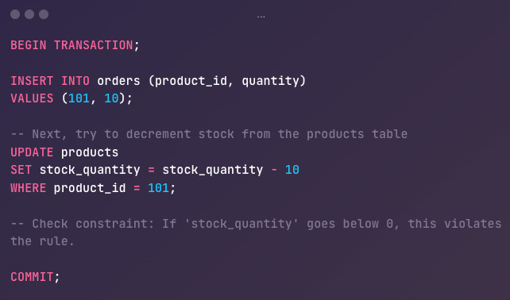
Consistency
Consistency in the context of ACID transactions ensures that any transaction will bring the database from one valid state to another valid state never leaving it in a broken or “invalid” state.
How to Implement Consistency
Database Schema Constraints
NOT NULL, UNIQUE, PRIMARY KEY, FOREIGN KEY, CHECK constraints, and other schema definitions ensure no invalid entries are allowed.
Triggers and Stored Procedures
Triggers can automatically check additional rules whenever rows are inserted, updated, or deleted.
Stored procedures can contain logic to validate data before committing.
Application-Level Safeguards
While the database enforces constraints at a lower level, applications often add extra checks—like ensuring business rules are followed or data is validated before it even reaches the database layer.

Slide 4
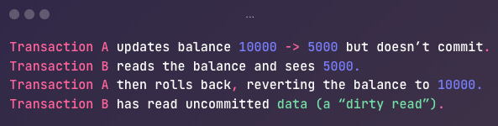
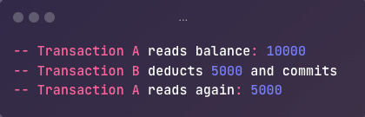
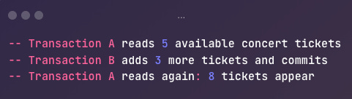
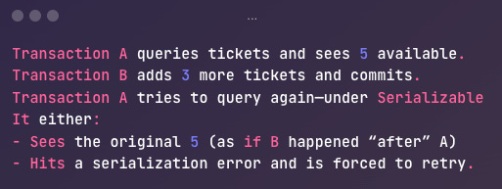
Isolation
Isolation ensures that concurrently running transactions do not interfere with each other’s intermediate states.
Concurrency Anomalies
Dirty Read
Non-Repeatable Read
Phantom Read
Isolation Levels
Read Uncommitted
Read Committed
Repeatable Read
Serializable
How Databases Enforce Isolation
Locking
MVCC (Multi-Version Concurrency Control)
Snapshot Isolation

Slide 5
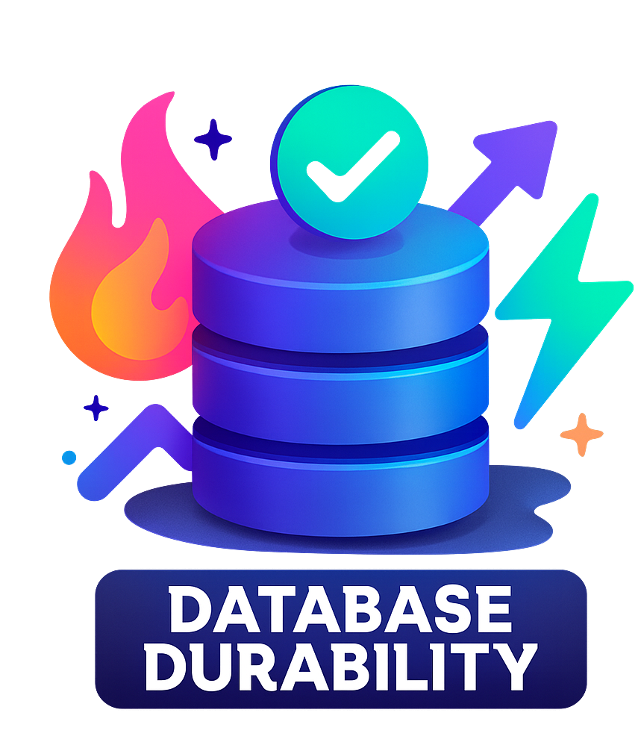
Durability
Durability ensures that once a transaction has been committed, the changes it made will survive, even in the face of power failures, crashes, or other catastrophic events.
How Databases Ensure Durability
1. Transaction Logs (Write-Ahead Logging)
Most relational databases rely on a Write-Ahead Log (WAL) to preserve changes before they’re written to the main data files.
2. Replication / Redundancy
In addition to WAL, many systems use replication to ensure data remains durable even if hardware or an entire data center fails.
3. Backups
Regular backups provide a safety net beyond logs and replication. In case of severe corruption, human error, or catastrophic failure:

